Slide 1
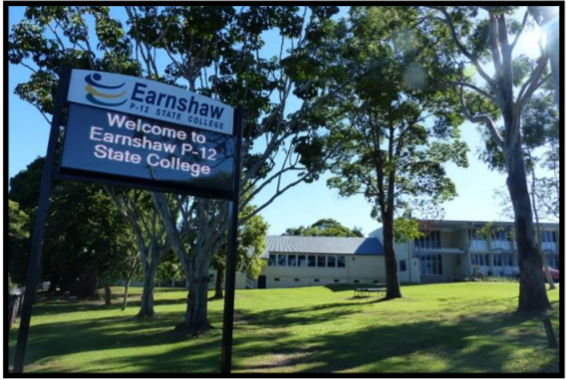
Student Support at Earnshaw State College in 2025

Slide 2
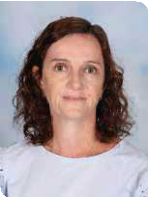
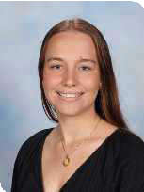
Student Support Team
Head of Inclusion: Meagan Speedy
Guidance Officer: Erin Thorpe (Primary) and Fiona Darlington (Secondary) NEW in 2025
Speech Language Pathologist: Libby O’Callaghan
Social Worker: Louise Du Rietz
Chaplain: Rosabelle Tully
Engagement Teacher: Bianca Jones
Support Teacher Literacy and Numeracy (primary only): Donna Whitson
Personalised Learning & Inclusion Support Teachers:
Year 10 -12 Naomi Keast Year 5 Devinder Bains
Year 8 -9 Christian Wilmer Year 3-4 Janine Blatch
Year 6 – 7 Steve Tweed Year 1 -2 Mardie Kummer
Prep - Tiffany Watson

Slide 3
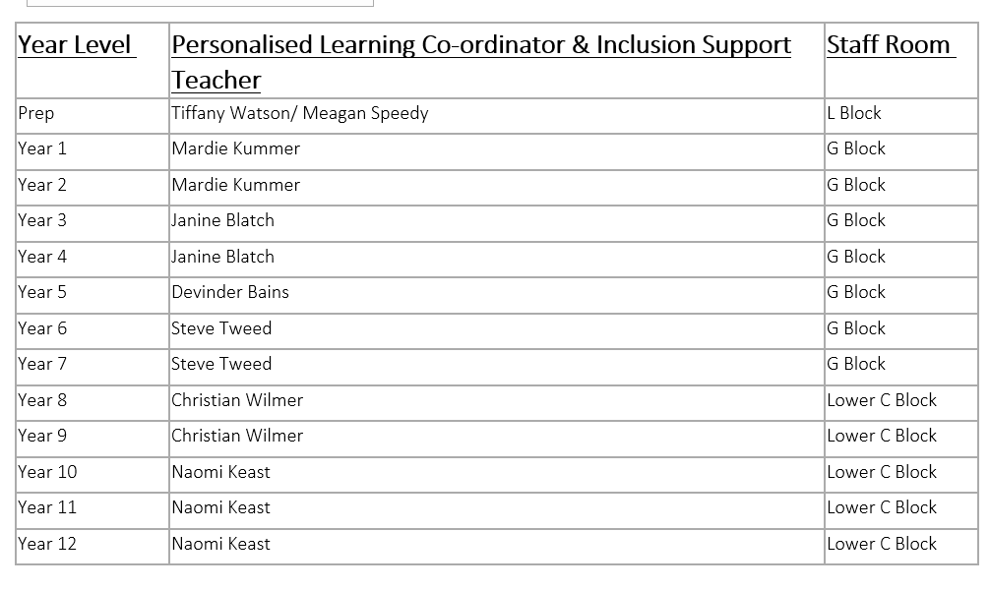
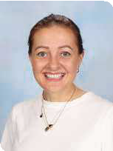
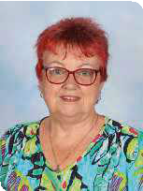
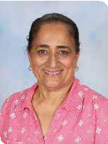
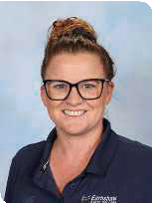
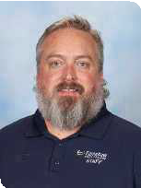

Slide 4
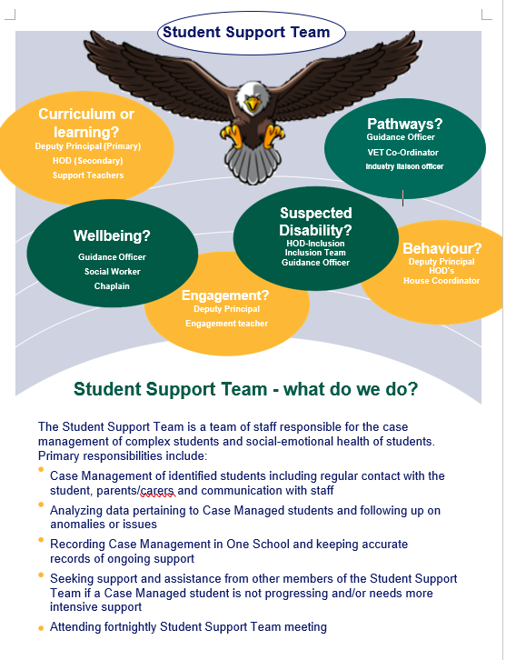

Slide 5
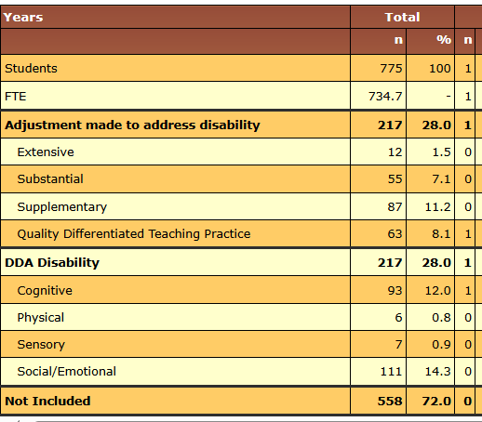
Who are our students @ESC?
NCCD – 28% school population were captured in 2024

Slide 6
Referral meetings
Pre-Meeting | SST Meeting | Post Meeting
Observed the student and initiated anecdotal recordkeeping and data collection. Class teacher has checked OneSchool for previous referrals, reports and plans (Check – under Support – Referrals & Report’s and Sensitive case records) Class teacher has checked that the student has a current PLP Class teacher has consulted with support team staff who are already engaged with the student Class teacher has discussed student with STLN and/or relevant DP/HOD Sought input on students’ previous history (OneSchool, files, previous teacher/s) Parent/carer contacted to obtain background information and discuss SST meeting process Is the student accessing external/outside of school support? Request a hearing & vision test and obtained results from parents/carers If concerns persist after implementing the recommended strategies, please refer to SST process and complete SST referral form. | Head of Department Inclusion receives referral form via SST Referral Process Head of Department Inclusion adds to SST meeting agenda Referral discussed at SST team Key actions and support decided upon Case Manager assigned, see ESC Case Management Process Email sent to students’ classroom teachers by SST delegate Details recorded in One School – SST Dashboard OneSchool | Key actions recorded on OneSchool and minutes enacted by relevant staff Assigned Case Manager to contact parents If required, assessments and reports completed, behaviour plans developed by key staff members Implementation of strategies Assigned Case Manager to conduct regular check ins between specialist staff, classroom teachers and student Review of data to inform student progress Documentation of case review Add any updates to SST meeting agenda

Slide 7
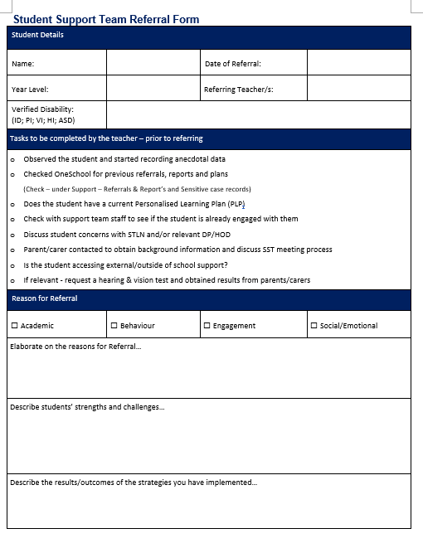
Referral to our Student Support Team
The purpose of a referral is to collaborate & case manage with other professionals (e.g. HoSeS, GO, SLP, Support Teachers, AVTs); not to hand over responsibility from classroom teacher to other staff.

Slide 8
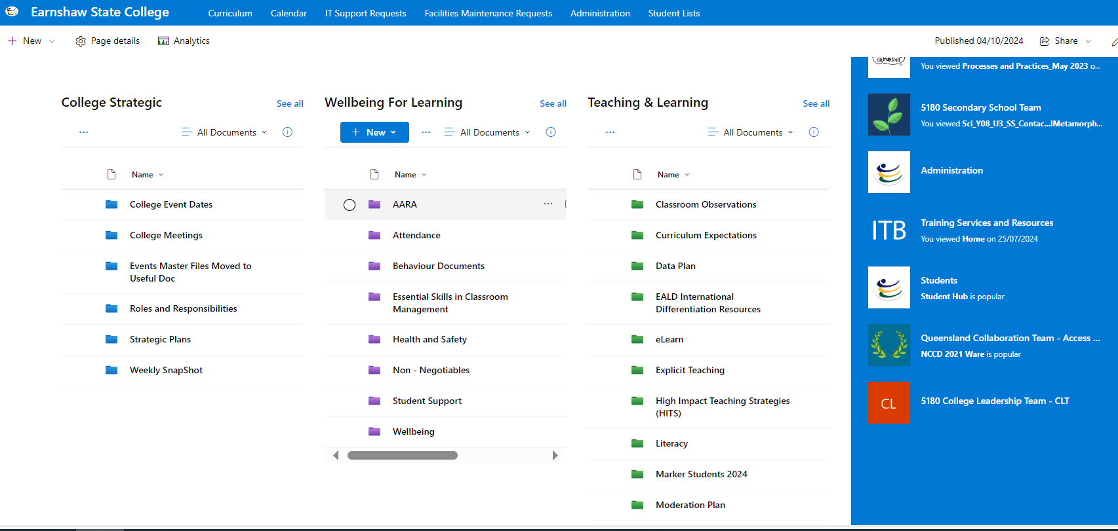
Share point

Slide 9
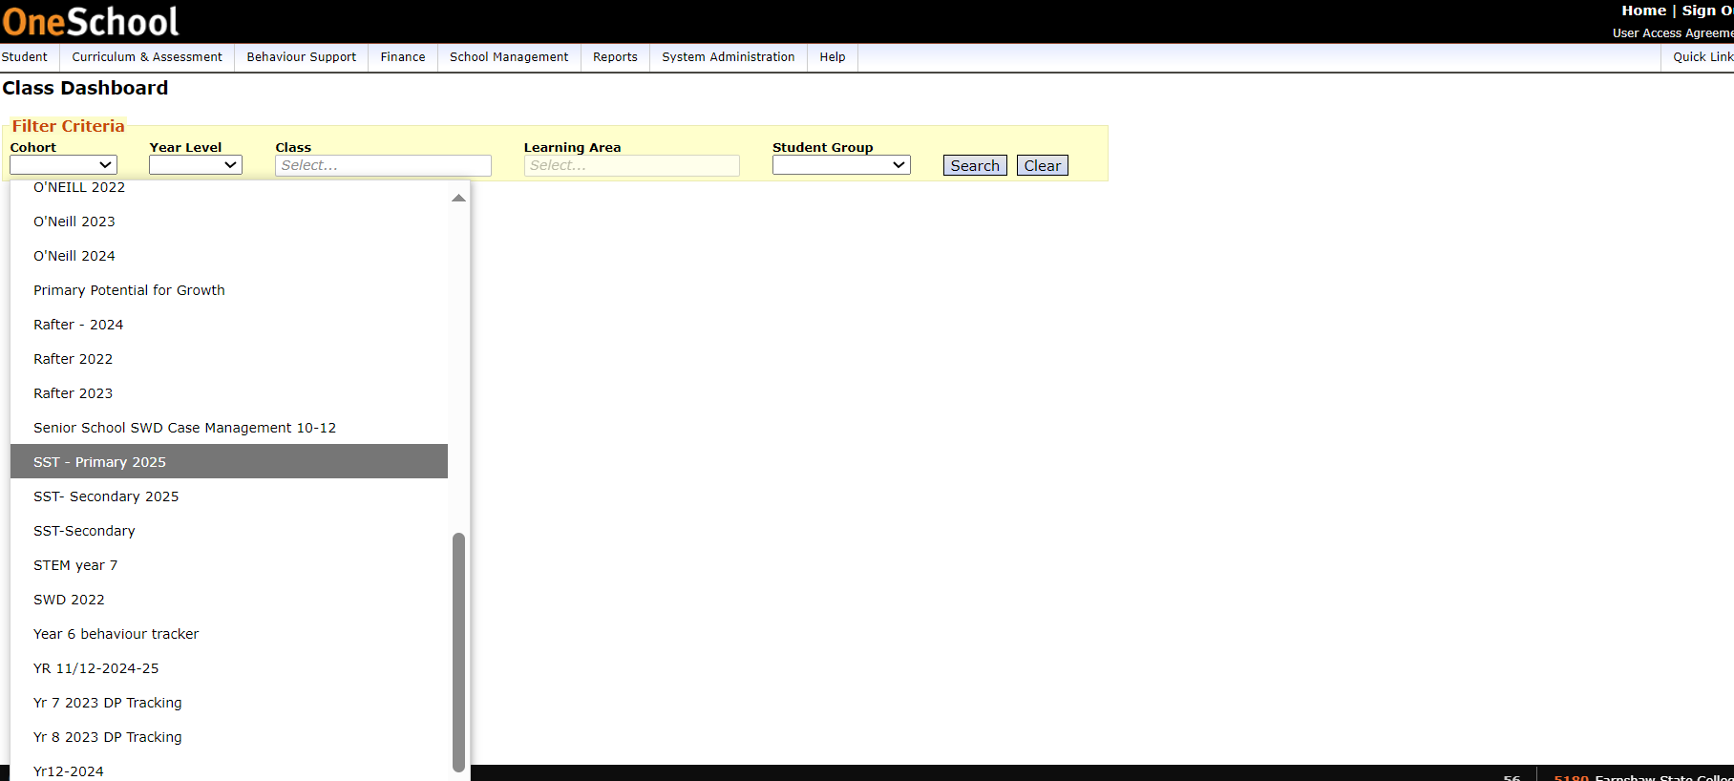
One School

Slide 10
Hierarchy of Support from our Student Support Team
Priority 1
Students who require support to address the functional impact of a disability
(Cognitive / Social-Emotional / Physical / Sensory)
Priority 2
Students – those who have achieved an E, thus requiring intensive support (either at year level to see if they respond to intervention or through ICP)
Priority 3
Students – those who have achieved a D and thus require ongoing support to learn at their year level, with differentiation.

Slide 11
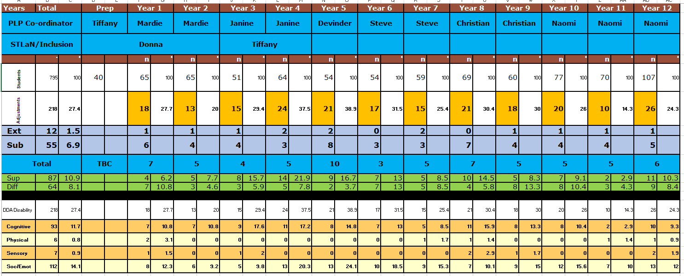

Slide 12
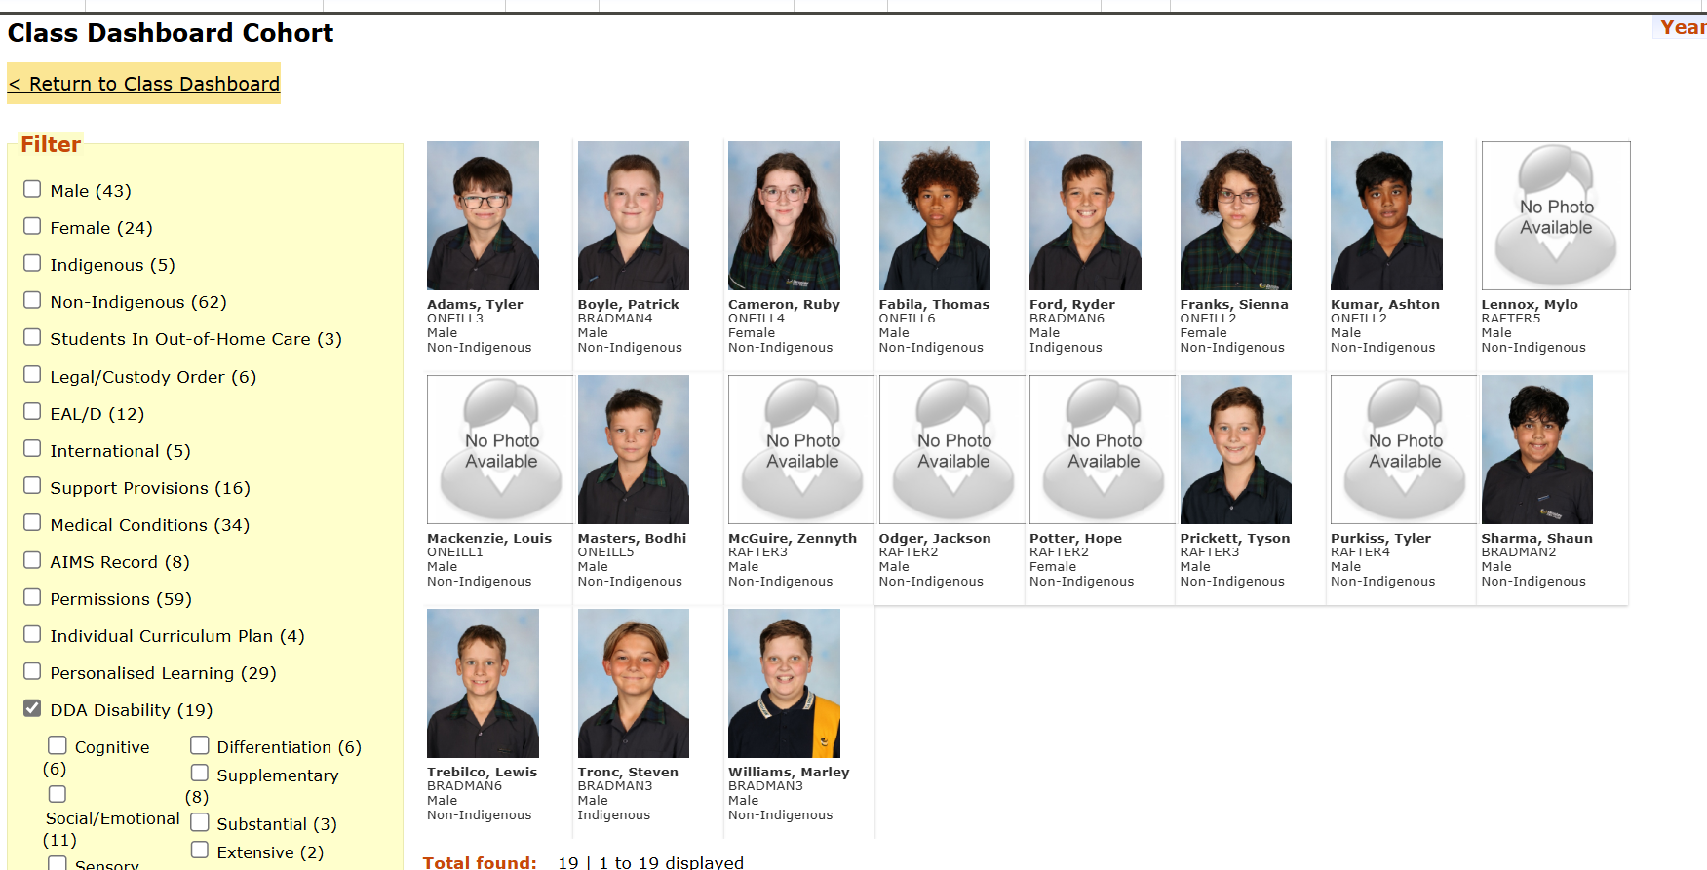

Slide 13
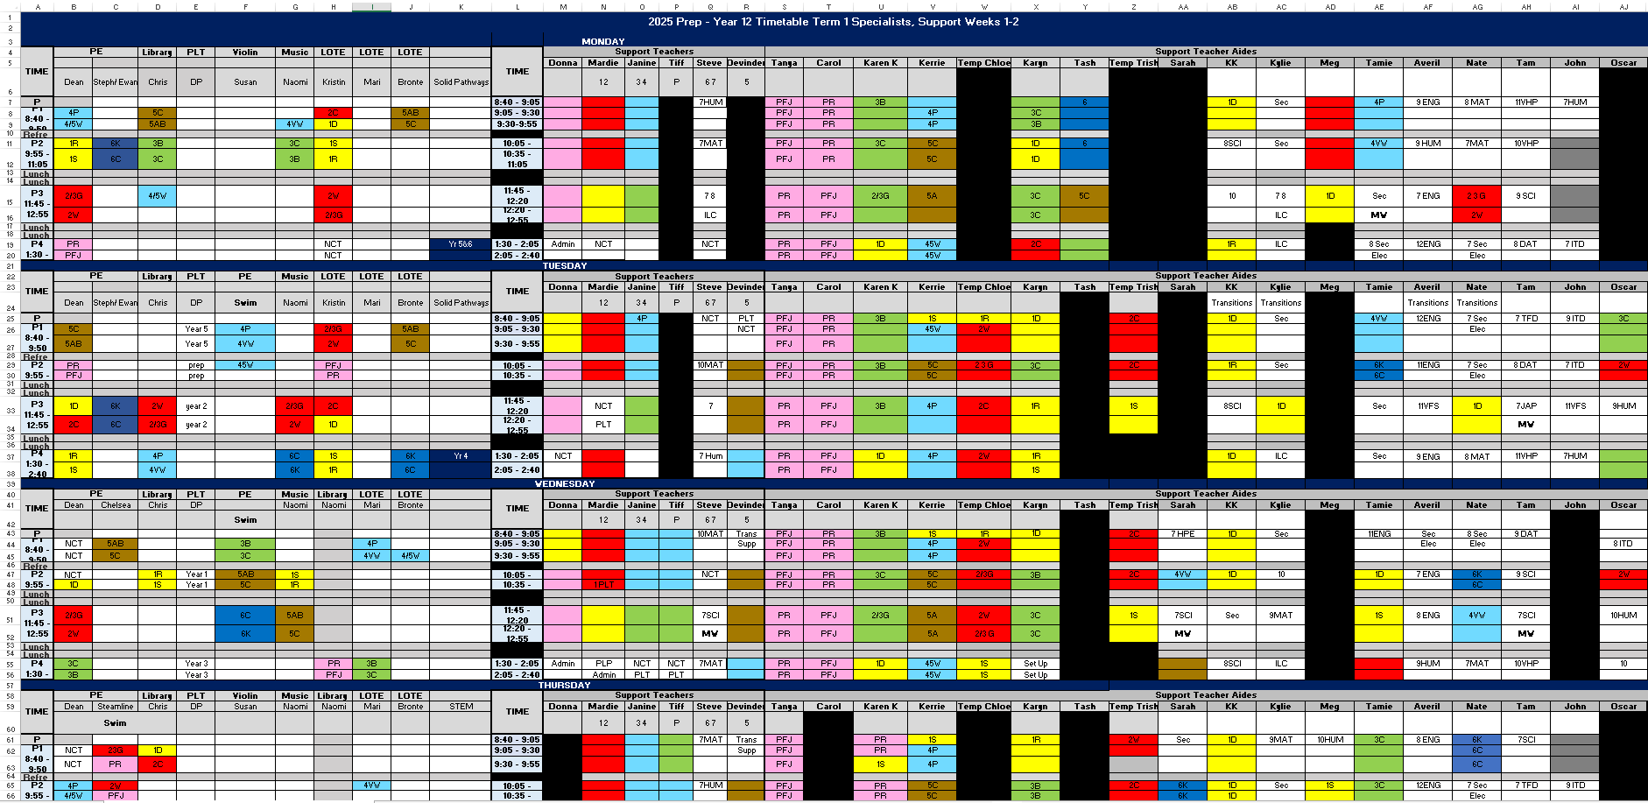

Slide 14
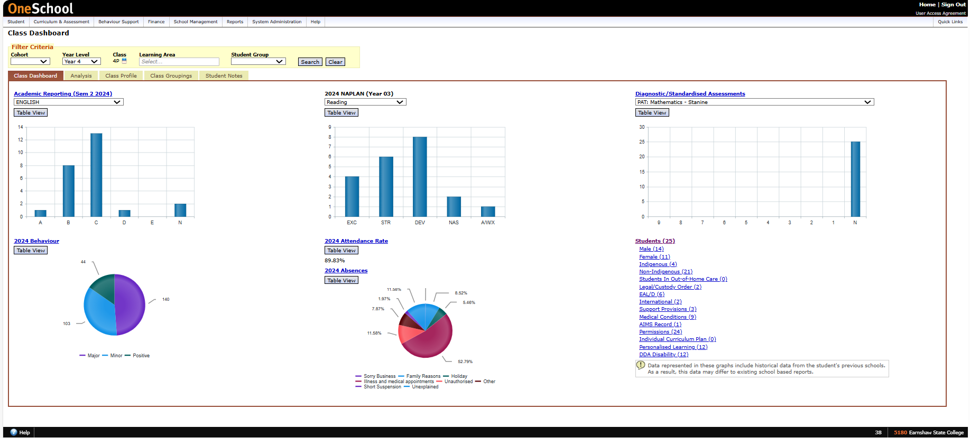
Know your students…

Slide 15
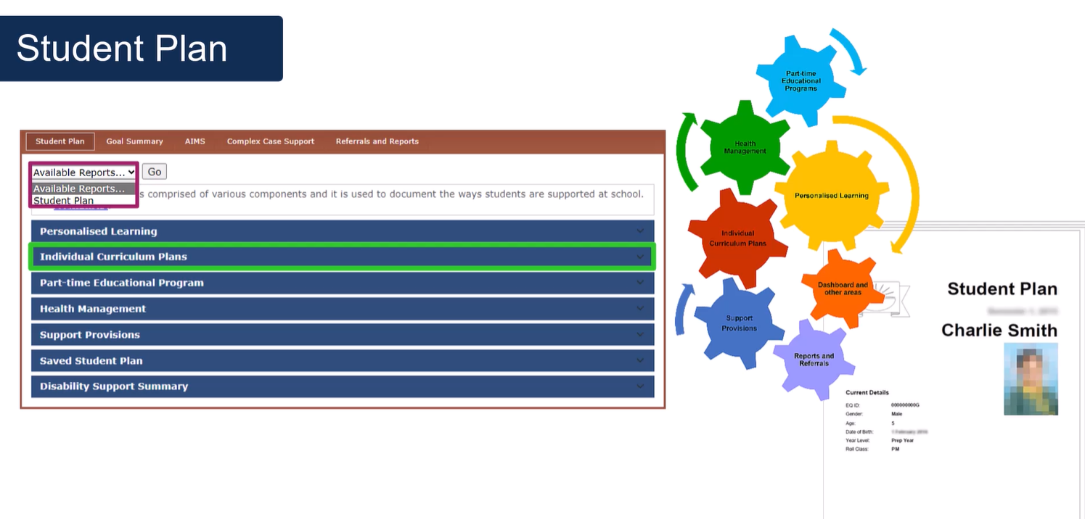

Slide 16
Health & Medical Management
Please communicate any new diagnosis directly to HOSES -Meagan as well as front office admin staff. We will update OS and determine if this requires further information from a specialist, input of the SRN (School Registered Nurse) for parent liaison and/or staff training, etc.
School Individual Health Plans (IHPs) and Emergency Health Plans (EHPs) are reviewed yearly or if circumstances change. HOSES responsible for coordinating these updates in consultation with the SRN (School registered nurse) / parents.
In the interim, please check OS Current Medical Conditions for students in your class.

